Slide 1
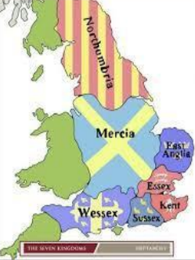
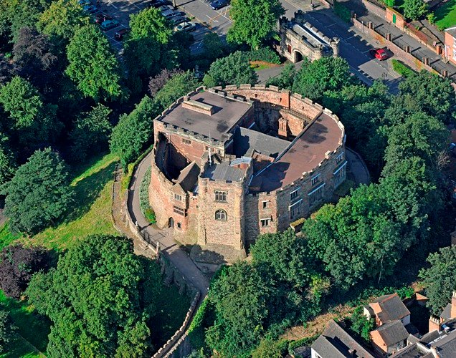
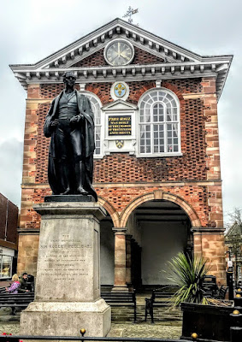
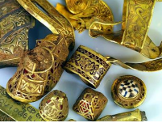
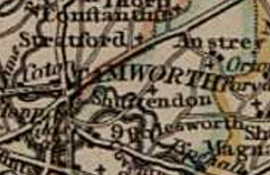
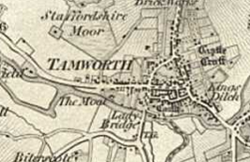
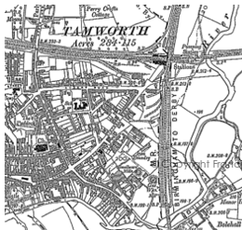
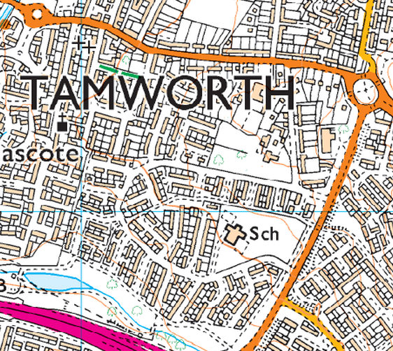
43-410 | 410- 1066 | 1066-1075 | 1154-1485 | 1485-1603 | 1603-1714 | 1714- 1837 | 1837-1914 | 1914-1945 | 1945 to present
The Romans | The Anglo-Saxons and Vikings | The Normans | The Plantagenets | The Tudors | The Stuarts | The Georgians | The Victorians and Edwardians | World Wars | Modern Britain
Anglo-Saxon
Tamworth began as a Saxon settlement in Staffordshire by the River Tame. It was made into an important place by King Offa who reigned from 755 to 796. Offa’s Kingdom of Mercia was ruled from Tamworth. Tamworth has a rich and fascinating history as the capital of the ancient Kingdom of Mercia and some of that heritage can still be seen and explored to this day. Tamworth was the heartland of the Mercian Kingdom, which had a royal church at Repton, a religious centre at Lichfield and the King’s main residence at Tamworth. Certainly the Mercian Kings spent more time at Tamworth than anywhere else.
TAMWORTH VOCABULARY
market town | A market town is a settlement most common in Europe that obtained by custom or royal charter, in the Middle Ages, a market right, which allowed it to host a regular market; this distinguished it from a village or city.
Mercia | The kingdom and earldom of central and south England during the Anglo-Saxon period that reached its height under King Offa (757–96).
Offa | Offa was King of Mercia, a kingdom of Anglo-Saxon England, from 757 until his death. He is best remembered for his Dyke, which he had built to act as a defence against the Welsh.
Royal charter | A written grant by the monarch or legislative power of a country, by which a city, company, or university is founded or its rights and privileges defined.
Hoard | A stock or store of valuable objects.
Tamworth Castle
In the 1080s, the Normans built a castle at Tamworth, which has stood guard over the town ever since. In the Middle Ages Tamworth was a small market town. However, the king gave it charters in 1319. In 1337 Tamworth was granted the right to hold two annual fairs. (In the Middle Ages fairs were like markets but they were held only once a year and they attracted buyers and sellers from far and wide).
Modern Times
In 1901 Tamworth had a population of 15,000. The first public library in Tamworth was built in 1905. Tamworth gained an electricity supply in 1924. During its long history, Tamworth has been a market town rather than an industrial centre although there was an industry making agricultural machines in the 20th century and Reliant made cars in Tamworth until 1999. There was also a paper-making industry in Tamworth as well as a textiles industry and one making aluminium ware. Ankerside Shopping Centre opened in 1980. Today the population of Tamworth is 77,000..
Staffordshire hoard
The Staffordshire Hoard is the largest collection of Anglo-Saxon gold and silver treasure ever found. It is made up of small and incredibly fine objects.
Tamworth 1500 to 1800
Tamworth was a small market town. In the 16th and 17th centuries Tamworth, like all towns, suffered from outbreaks of plague. It struck in 1563, 1579, 1597-98, 1606, and 1626. In 1678 a man named Thomas Guy founded alms houses in Tamworth (they were rebuilt in 1913). He also built Tamworth Town Hall in 1701 and later founded Guys Hospital in London.
Tamworth Knowledge Organiser
1806
1834
1921
2000

